Slide 1


Slide 2


Slide 3


Slide 4
Windows 11.3

Slide 5
Windows 11.3
Install Now
Repair PC
©2024 Microsoft Corporation

Slide 6
Setup is starting

Slide 7

Accept the license agreement
Microsoft Software License Terms Last updated: October, 2024 This is not an actual OS, it’s just an OS Concept made by 7Zeb. Made in PowerPoint, some UI elements made in Canva. Project started on: October 7, 2024 https://7zeb.neocities.org/
https://www.microsoft.com/
Accept

Slide 8
Where do you want to install Windows?
Loading drive information…

Slide 9






Where do you want to install Windows?
2TB Samsung 980 Pro M.2 SSD
Delete
Format
Recover
New
Next

Slide 10
Enter your product key
To verify that your Windows installation is genuine, enter the product key, the product key can be found on the box that you bought Windows, or on the sticker of your computer. An example will look like XXXXX-XXXXX-XXXXX-XXXXX-XXXXX
I don’t have a product key
Next

Slide 11
Enter your product key
To verify that your Windows installation is genuine, enter the product key, the product key can be found on the box that you bought Windows, or on the sticker of your computer. An example will look like XXXXX-XXXXX-XXXXX-XXXXX-XXXXX
H743J-JD483-N46G4-J4H47-K3HR4J
I don’t have a product key
Next

Slide 12
Installing Windows 11.3
Windows 11.3 is currently being installed, sit back and relax while it’s being installed.

Slide 15
Windows 11.3 is getting ready…

Slide 16
Welcome
Welcome to Windows 11.3, click next to continue.
Next

Slide 17



Connect to the Internet
Please connect to the internet to continue with setup.
Search
RutwikStuffCorp
Next

Slide 18
Connect to the Internet
Please connect to the internet to continue with setup.
Search
RutwikStuffCorp
Next

Slide 19
Connect to the Internet
Enter the password for the network.
RutwikStuffCorp
Next

Slide 20
Connect to the Internet
Enter the password for the network.
RutwikStuffCorp
************
Next

Slide 21
Just a moment…

Slide 22
Checking for updates…

Slide 23

Windows found an update
Windows has found an update to Windows 11.3
Info: Windows 11 11.3 Version 24H2 Build: 29.0 (Build: 27794) Compile Day: 11/19/2024
Install
Ignore

Slide 24
Downloading Windows Update file
Windows is updating, sit back and relax.
Downloading Update files…

Slide 25
Downloading Windows Update file
Windows is updating, sit back and relax.
Downloading Update files…

Slide 26
Downloading Windows Update file
Windows is updating, sit back and relax.
Downloading Update files…

Slide 27
Downloading Windows Update file
Windows is updating, sit back and relax.
Downloading Update files…

Slide 28
Downloading Windows Update file
Windows is updating, sit back and relax.
Downloading Update files…

Slide 29
Downloading Windows Update file
Windows is updating, sit back and relax.
Downloading Update files…

Slide 30
Downloading Windows Update file
Windows is updating, sit back and relax.
Downloading Update files…

Slide 31
Downloading Windows Update file
Windows is updating, sit back and relax.
Downloading Update files…

Slide 32
Downloading Windows Update file
Windows is updating, sit back and relax.
Downloading Update files…

Slide 33
Downloading Windows Update file
Windows is updating, sit back and relax.
Downloading Update files…

Slide 34
Downloading Windows Update file
Windows is updating, sit back and relax.
Downloading Update files…

Slide 35
Downloading Windows Update file
Windows is updating, sit back and relax.
Downloading Update files…

Slide 36
Downloading Windows Update file
Windows is updating, sit back and relax.
Downloading Update files…

Slide 37
Downloading Windows Update file
Windows is updating, sit back and relax.
Downloading Update files…

Slide 38
Downloading Windows Update file
Windows is updating, sit back and relax.
Downloading Update files…

Slide 39
Windows is Updating…
0% Complete Please do not turn of your computer.

Slide 40
Windows is Updating…
10% Complete Please do not turn of your computer.

Slide 41
Windows is Updating…
15% Complete Please do not turn of your computer.

Slide 42
Windows is Updating…
20% Complete Please do not turn of your computer.

Slide 43
Windows is Updating…
25% Complete Please do not turn of your computer.

Slide 44
Windows is Updating…
30% Complete Please do not turn of your computer.

Slide 45
Restarting…

Slide 47
Windows is upgrading your system.
35% Complete
Please do not turn off your computer.

Slide 48
Windows is upgrading your system.
50% Complete
Please do not turn off your computer.

Slide 49
Windows is upgrading your system.
75% Complete
Please do not turn off your computer.

Slide 50
Windows is upgrading your system.
80% Complete
Please do not turn off your computer.

Slide 51
Windows is upgrading your system.
90% Complete
Please do not turn off your computer.

Slide 52
Windows is upgrading your system.
95% Complete
Please do not turn off your computer.

Slide 53
Just a moment…

Slide 54





Sign in to your Microsoft Account
Sign in to your Microsoft Account to get more features.
Microsoft
Sign In
Sign In Options
Forgot Password
Don’t have a Microsoft account, create one Here
Next

Slide 55
Sign in to your Microsoft Account
Sign in to your Microsoft Account to get more features.
Microsoft
Sign In
rutwikcity1@gmail.com
Sign In Options
Forgot Password
Don’t have a Microsoft account, create one Here
Next

Slide 56
Sign in to your Microsoft Account
Sign in to your Microsoft Account to get more features.
Microsoft
Enter your password.
Sign In Options
Forgot Password
Don’t have a Microsoft account, create one Here
Next

Slide 57
Sign in to your Microsoft Account
Sign in to your Microsoft Account to get more features.
Microsoft
Enter your password.
************
Sign In Options
Forgot Password
Don’t have a Microsoft account, create one Here
Next

Slide 58


Restore a backup?
Would you like to restore a backup from a previous computer?
DESKTOP-JSSE833
Windows 10 22H2
DESKTOP-MLSE833
Windows 10 22H2
VMware 13
Windows 11 24H2
Skip

Slide 59
Copilot your helpful AI assistant
Would you like copilot to automatically start with Windows?
Yes (recommended)
Copilot will automatically start with Windows, so you're ready to go quickly.
No
You can still start Copilot from the taskbar, start menu, or the copilot key on your keyboard.

Slide 60
Copilot your helpful AI assistant
Would you like copilot to automatically start with Windows?
Yes (recommended)
Copilot will automatically start with Windows, so you're ready to go quickly.
No
You can still start Copilot from the taskbar, start menu, or the copilot key on your keyboard.
Next

Slide 61



Choose your theme.
Would you like to use light or dark mode.
Aa
Aa
Next

Slide 62
Choose your theme.
Would you like to use light or dark mode.
Aa
Aa
Next

Slide 63

Choose a color.
Choose the default color you want to use for Windows.
Choose a custom color
Next

Slide 64
Choose a color.
Choose the default color you want to use for Windows.
Choose a custom color
Next

Slide 65
4:15 PM
Saturday, November 23, 2024

Slide 66
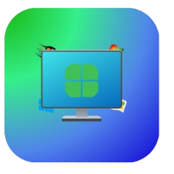
7Zeb

Slide 67
7Zeb
************

Slide 68
Hi

Slide 69
We’re getting things ready for you.

Slide 70
Please Wait while we get things set up.
Please do not turn of your computer.

Slide 71
Please Wait while we get things set up.
Please do not turn of your computer.

Slide 72
Please Wait while we get things set up.
Please do not turn of your computer.

Slide 73
Please Wait while we get things set up.
Please do not turn of your computer.

Slide 74
Please Wait while we get things set up.
Please do not turn of your computer.

Slide 75


Widgets
Windows 11.3 let’s you add Widgets to the desktop, just like how gadgets used to work.

Slide 76

Rounded Corners.
Windows 11.3 has rounded corners which makes it look better.

Slide 77
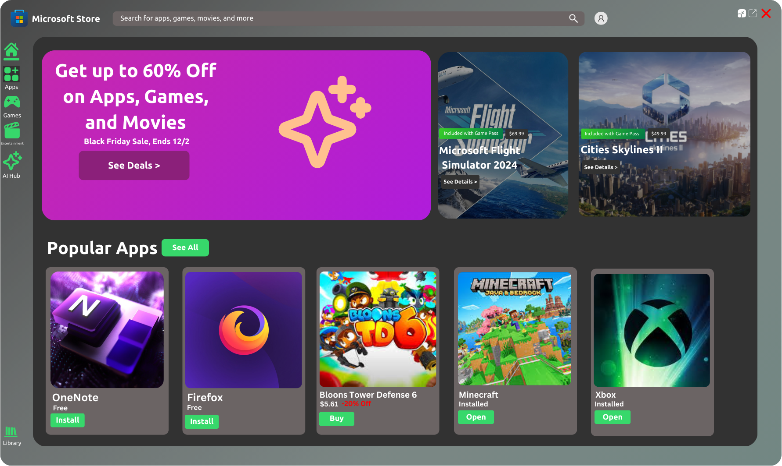
Microsoft Store
Windows 11.3 gives the Microsoft Store a new look.

Slide 78
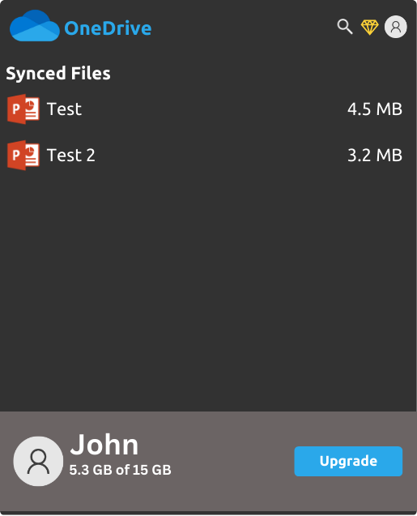
OneDrive Sync
Windows 11.3 automatically backs up your files to OneDrive so that you can have an eadier way of viewing them.

Slide 79
OneDrive Sync
Windows 11.3 automatically backs up your files to OneDrive so that you can have an eadier way of viewing them.

Slide 80
Let's Start

Slide 81







Recycle Bin
Microsoft Edge
4:22PM 11/23/2024

Slide 82


Recycle Bin
Microsoft Edge
4:22PM 11/23/2024

Slide 83

Recycle Bin
Microsoft Edge
4:22PM 11/23/2024

Slide 84

Recycle Bin
Microsoft Edge
7Zeb is a tech YouTuber who is passionate about the Windows operating system. They create content related to various Windows builds, tutorials on dual-booting different Windows versions, and exploring lesser-known features of Windows operating systems
Does this seem like something you would watch?
4:22PM 11/23/2024

Slide 85
Recycle Bin
Microsoft Edge
4:22PM 11/23/2024

Slide 86



Recycle Bin
Start
7Zeb
Search for apps, settings, and documents.
Edge
Word
4:22PM 11/23/2024

Slide 87
Recycle Bin
Start
7Zeb
Search for apps, settings, and documents.
Display
Internet
Properties
Edge
Word
4:22PM 11/23/2024

Slide 88

Recycle Bin
Microsoft Edge
4:22PM 11/23/2024

Slide 89

Recycle Bin
About this PC
DESKTOP-SHD84J3
Lenovo IdeaPad Flex 14API
Microsoft Edge
Computer Specs:
AMD Ryzen 7 3700U with Radeon Vega Mobile Gfx 2.30Ghz
20GB RAM (17.9GB Usable) AMD Radeon Vega 10X Graphics x64 Bit Operating System, x64 Bit Processer 10 touch points.
Windows 11.3 Home Edition
4:22PM 11/23/2024

Slide 90


Recycle Bin
Start
7Zeb
Search for apps, settings, and documents.
Sleep
Shut Down
Restart
Edge
Word
For Testing Purposes only
Windows 11.3 Build 59.0
4:22PM 11/23/2024

